Slide 1
Racial Differences in Marriage Trends

Slide 2
Racial Differences: Marriage
Timing of marriage: divergent trends
Marriage rates: Black individuals less likely to marry
Divorce rates: higher among Black population

Slide 3
1. Timing of marriage
Late 1800s – 1940s: Black individuals marry at younger ages
1950s: White population marries earlier; few racial/ethnic differences
Post 1950s: Black people marry later (if they do marry)
Median age at first marriage (2021 data)
Black Men: 33 White Men: 30
Black Women: 32 White Women: 27.9

Slide 4
2.Marriage rates
Black population less likely to marry overall
1950: 9/10 Black women would marry
2015: 45% of Black women married by age 40
60% of white women
55% of Hispanic women
2020: 47.5% of Black women never married

Slide 5
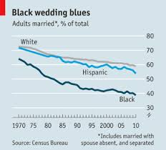
Marriage rates

Slide 6
3.Divorce rates
Black marriages break up more often
2022 – Percentages of divorced women
Black women – 33%
Hispanic women – 22%
White women – 19%
Asian women – 11%

Slide 7
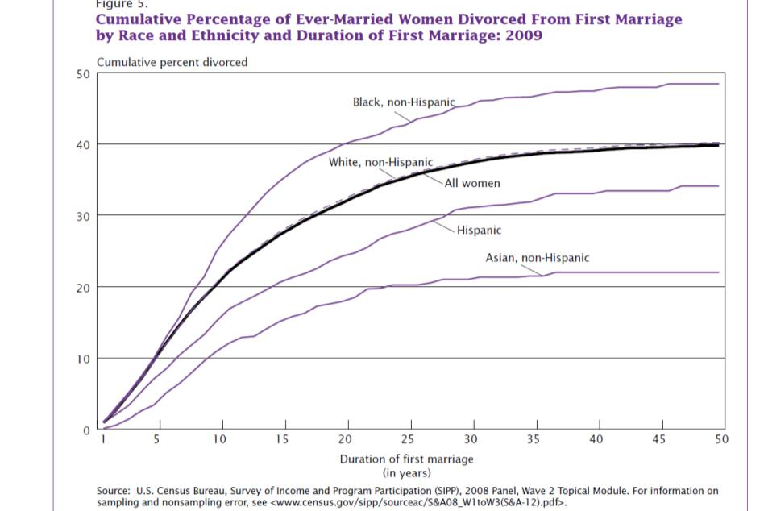
Divorce rates

Slide 8
Why do we care about marriage and divorce rates?

Slide 9
What explains these differences?

Slide 10
Explanations
Legacy of slavery
Marriage common in early 20th C.
Marriage market – structural changes
“Marriageable men”
Education mismatch
Intermarriage rates
But 1960-1980 rise of middle-class Black Americans
Ratio of men’s to women’s wages; smaller amongst Black Americans
Suggest differences among most economically unstable

Slide 11
Racial Gap at all Educ LEvels
White women – higher education = more stable marriages
Black women – instability at all education levels
Returns to education investment lower for black men?
Since 1960, economic factors impact marriage formation
Black men and women face economic disadvantage

